Slide 1
MovieDiscuss
By O’Brien team

Slide 2
Outline
Project Background
Team members and roles
Kanban Board
Actions Taken On Project Feedbacks
MVP Demo
Team Reflection

Slide 3

Project Background
Why? What? Who?
To: Create a community for movie watchers online
By: Developing a website where people can view recommendations, rate movies, and discuss about movies of interest in real time via chat rooms.

Slide 4
Team members and roles
Aryan Chandra - Full stack developer
Nikita Khavronin - Project Manager, full stack developer
Stephanie Ndulue - Project documentation & front-end developer

Slide 5
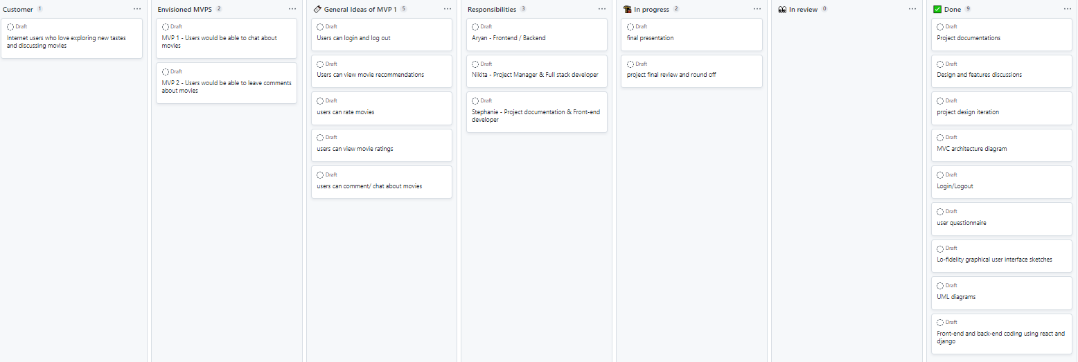
Kanban board

Slide 6
Actions Taken On Project Feedbacks
“The MVP's could've been explained in a bit more of a detail and what it would look like when a user is exploring it not the developer itself”
“I would've liked it if the prototyping was done on digital software as the prototype gives the sense of what your User Interactive product is going to look like.”
“I noticed that the only user specified is the “Movie Watcher”. Perhaps you guys want to target a more specific audience or age group and cater the site to them?” & “People may be able to chat about movies but It is even tough to create good community environment”

Slide 7
MVP Demo
Our working MVP
What makes it an MVP?
What is our team happy with?
What does our team think could potentially be better?

Slide 8
Team reflection
How did we feel about this project? Was it successful?
What did your team feel most proud of throughout the entire project experience?
What did we learn about ourselves as you collaborated and worked on this project?
How will we use what we have learned/experienced in this project going forward?

Slide 9
THANK YOU

